Slide 1
NYPD Arrest Data (Year to Date)

Slide 2
New York City crimes has been rising nowadays and I experienced it personally so I was interested to know more which race, what are their offenses and gender that has been arrested with a highest violations. The data was taken from: https://data.cityofnewyork.us/Public-Safety/NYPD-Arrest-Data-Year-to-Date-/uip8-fykc. It was obtained via (API) CSV file.

Slide 3
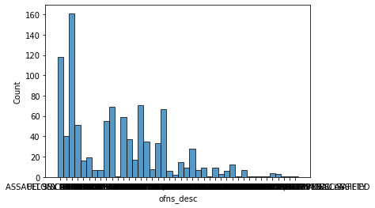
The graph shows that the assault 3 and other offenses has the highest value.
There were 161 cases.

Slide 4
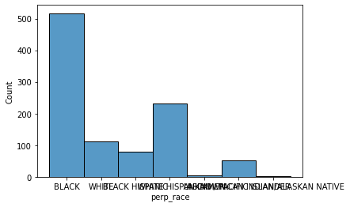
Mostly of the black people got more violations.
There were 499 offenses that was committed.

Slide 5
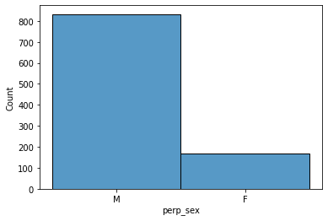
Male who committed more offenses.
Approximately 800 counts being recorded by the NYPD.

Slide 6
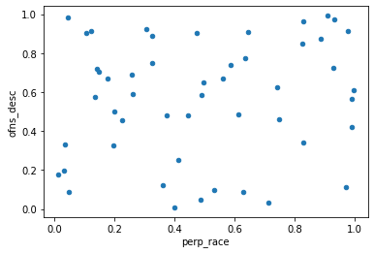

Slide 7
In conclusion as part of the precautionary action we should always consider the type of crimes we had in our area and the people we should go along with. This is very crucial in our own awareness and safety in the city we lived. Based on the data presented mostly of the male black people with assault 3 and other type of offenses committed crimes.

